Slide 1
Get the Route for minimum flight delay between two cities
-- A optimization of linear programming
Team Member:
Shangxing Jiang
Liyan Chen
Yanghongbo Lu

Slide 2
Agenda
Introduction the problem
The Data Acquisition and preprocessing
Modelling and Algorithm
Linear Programming
Results and Findings

Slide 3
Introduction the problem
Overview
We model the problem of finding minimum-delay route between two cities as a shortest path problem with stochastic costs.
Graph Theory is used to abstract all the flights forming our model.
Dijkstra’s Algorithm is used to calculate the shortest path between Nodes(Airports).

Slide 4
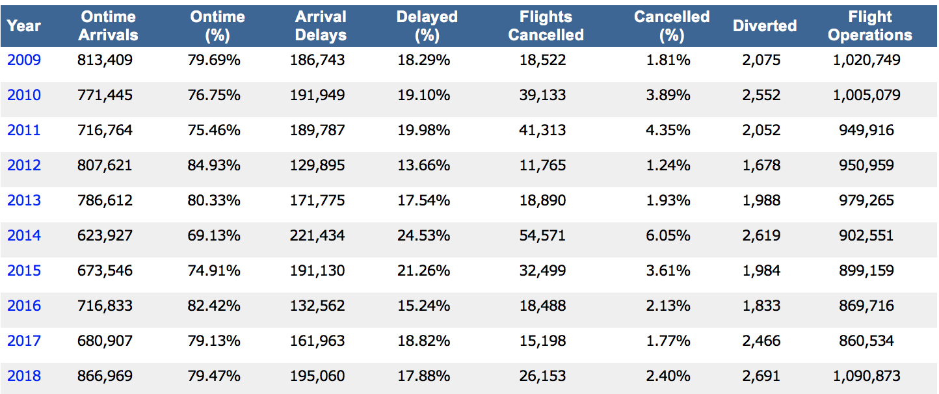
Introduction the problem
Background
“The total cost of domestic air traffic delays to the U.S. economy was as much as $32.9 billion for 2007.”
– U.S. Congress Joint Economic Committee
Nearly 20% flights delayed in US.
Flight delay is a problem both for travelers and airlines.

Slide 5
Introduction the problem
Meaning of solving this problem
For airlines, identifying the causes of delay and predicting potential flight delays allow them to make smart schedules and improve their service.
For passengers, the ability to predict flight delay would allow them to make better informed decisions when making travel plans.

Slide 6
The Data Acquisition
Source：The US Transportation Bureau
Airline On-Time Performance Data
Overview: data from 1980-2018.1
The development of technology have influence on the delay
Data: Choose data from 2017.1-2018
Total: 585w+(too much!)
Filter: Finding the 15th busiest airports in US as the origin
Constraints: the total amount of the flight out as the degree
Tools： Gephi and Excel
Result: 19w+

Slide 7
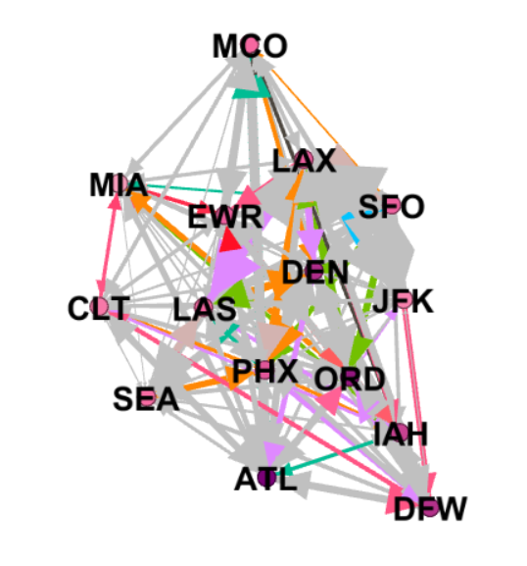
The 15th busiest airports in US
ATL
CLT
DEN
DFW
EWR
IAH
JFK
LAS
LAX
MCO
MIA
ORD
PHX
SEA
SFO

Slide 8
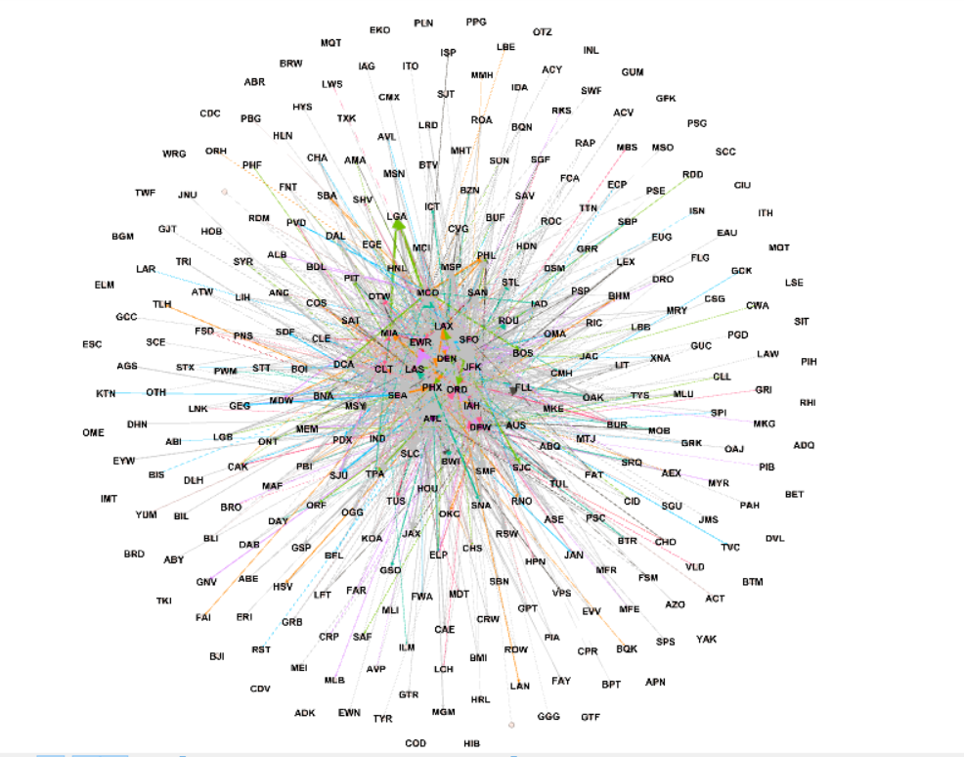
Total airline of the 15 airports
Origin | 15
Destination | 229
Count | 197389
Max delay | 1455
Min delay | -98
Ave delay | 8.44516918

Slide 9
Group | Dalay | Frequency | Percentage | Accumulation
1 | -98 | 1 | 0.00% | 0.00%
2 | -20 | 25536 | 12.94% | 12.94%
3 | 58 | 155777 | 78.92% | 91.86%
4 | 136 | 11539 | 5.85% | 97.70%
5 | 214 | 3014 | 1.53% | 99.23%
6 | 292 | 882 | 0.45% | 99.68%
7 | 370 | 294 | 0.15% | 99.82%
8 | 448 | 129 | 0.07% | 99.89%
9 | 526 | 42 | 0.02% | 99.91%
10 | 604 | 44 | 0.02% | 99.93%
11 | 682 | 36 | 0.02% | 99.95%
12 | 760 | 29 | 0.01% | 99.97%
13 | 838 | 19 | 0.01% | 99.98%
14 | 916 | 12 | 0.01% | 99.98%
15 | 994 | 17 | 0.01% | 99.99%
16 | 1072 | 8 | 0.00% | 99.99%
17 | 1150 | 3 | 0.00% | 100.00%
18 | 1228 | 2 | 0.00% | 100.00%
19 | 1306 | 2 | 0.00% | 100.00%
20 | 1384 | 2 | 0.00% | 100.00%

Slide 10
Histogram
Concentrated in [58,136)

Slide 11
Delay description
Reference：American Airlines, Delta Air Lines, Southwest Airlines, United Airlines, Frontier Airlines, JetBlue, Alaska Airlines, Hawaiian Airlines, Spirit Airlines, Virgin America
Delay in plan: 30-60 mins(Taxi-in, Taxi-out, Traffic control, Loading)
Acceptable delay: <=3 hrs (Weather, Traffic control)
98% flights in US have acceptable delay.
However, delay still makes traveler annoyed!
Traveler need: Selecting a min delay airline!

Slide 12
Graph Theory
A graph G = (V,E) is a set of vertices V, and edges E. For nodes a, b ∈ V , the notation (a, b) ∈ E indicates that there is an edge from a to b in G.
Airport₂
……
Airport₁
Airport_{n}

Slide 13
If direction and weights are introduced to our graph. G = (V, E, W)
i.e. All edges have their directions and associated weights.
W_{2,n}
Airport₂
……
W_{1,2}
Airport₁
Airport_{n}
W_{1,n}

Slide 14
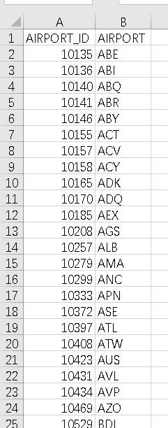
Data Preprocessing
Graph: directed
Nodes: Airports
Node id: get from The US Transportation Bureau
Edges: Airline
Source: Origin airport (15)
Target: Destination airport(229)
Weight: Distance or Delay?

Slide 15
Distance or Delay
Problem: Delay may be negative
Assume: (JFK,IAD)=-3,(IAD,EWR)=2,(JFK,EWR)=3
The program may choose (JFK,IAD,EWR)=-1 WRONGE!
Airtime is more important when choosing a flight
Airtime has positive correlation with distance
Result: Choose distance as the first constraints and than consider the delay.

Slide 16
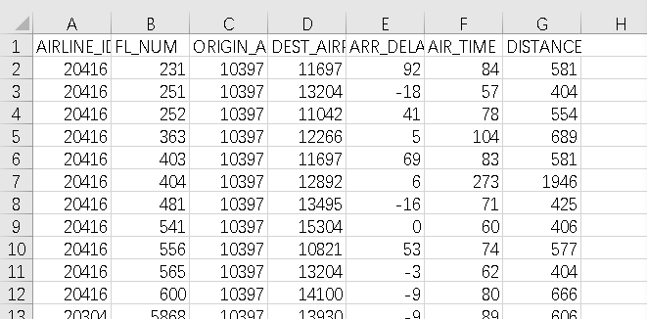
Airline: a route from origin to destination
Flight: there may be several different flights following a same airline offered by different companies.
Using the pivot table to find distance of different airlines and average delay for all the flights.

Slide 17
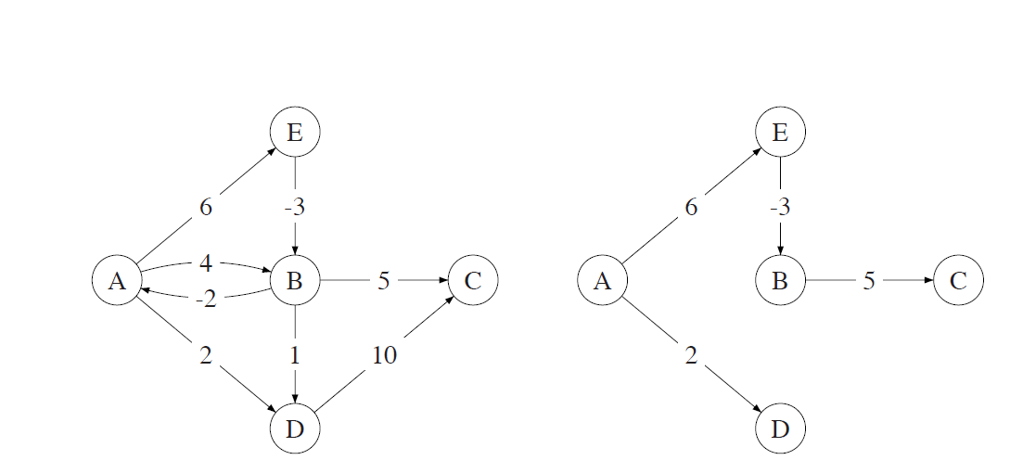

The Shortest path problem
predecessor function π : V →V , mapping a vertex with has the shortest path to the origin
function d : V →R , the weight of the shortest path between the origin node and another node
Required:π, d, origin $n_{o}$, destination $n_{d}$
n ← $n_{d}$
path ←list($n_{d}$)
repeat
n ← π(n)
append n to path
until n = io $n_{o}$
reverse path
return path, d($n_{d}$)

Slide 18
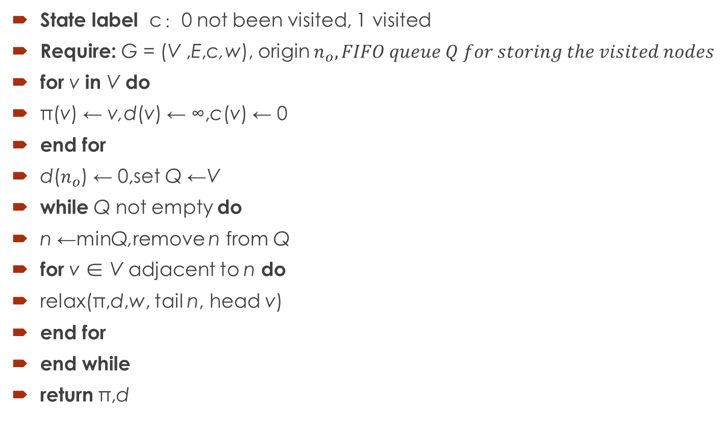
Dijkstra’s Algorithm
State label c：0 not been visited, 1 visited
Require: G = (V ,E,c,w), origin $n_{o}, FIFO queue Q for storing the visited nodes$
for v in V do
π(v) ← v,d(v) ← ∞,c(v) ← 0
end for
d($n_{o}$) ← 0,set Q ←V
while Q not empty do
n ←minQ,remove n from Q
for v ∈ V adjacent to n do
relax(π,d,w, tail n, head v)
end for
end while
return π,d

Slide 19
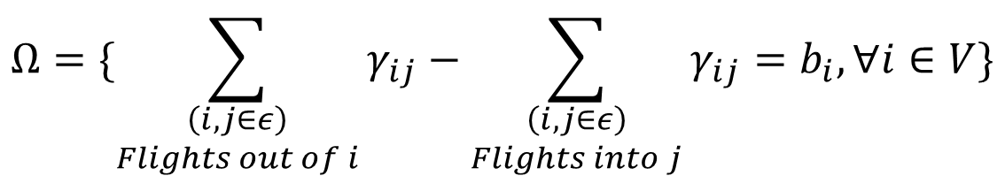

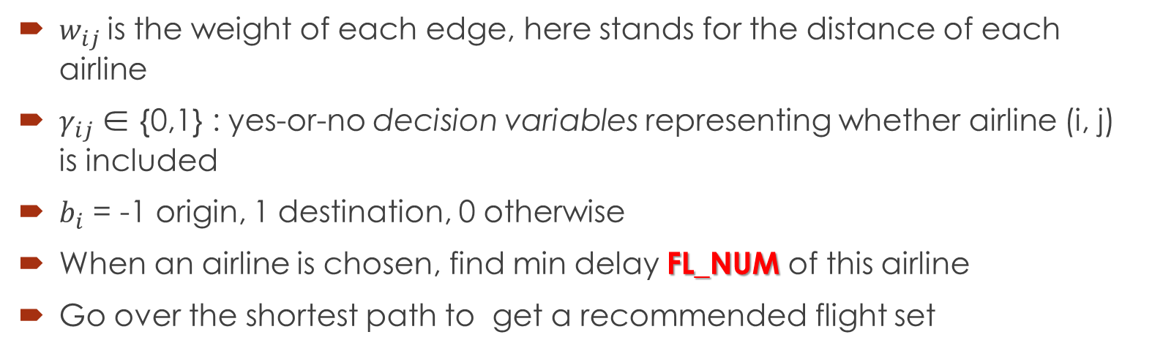
Optimization Model
$$min⁡\{\sum_{\left(i,j∈E\right)}{w_{ij}γ_{ij}:}γ_{ij}∈Ω\}$$
$$Ω=\{\sum_{\begin{aligned}\left(i,j∈ε\right) \\ Flights out of i\end{aligned}}{γ_{ij}−\sum_{\begin{aligned}\left(i,j∈ε\right) \\ Flights into j\end{aligned}}{γ_{ij}=b_{i},∀i∈V}}\}$$
$w_{ij}$ is the weight of each edge, here stands for the distance of each airline
$γ_{ij}$∈ {0,1} : yes-or-no decision variables representing whether airline (i, j) is included
$b_{i}$ = -1 origin, 1 destination, 0 otherwise
When an airline is chosen, find min delay FL_NUM of this airline
Go over the shortest path to get a recommended flight set

Slide 20
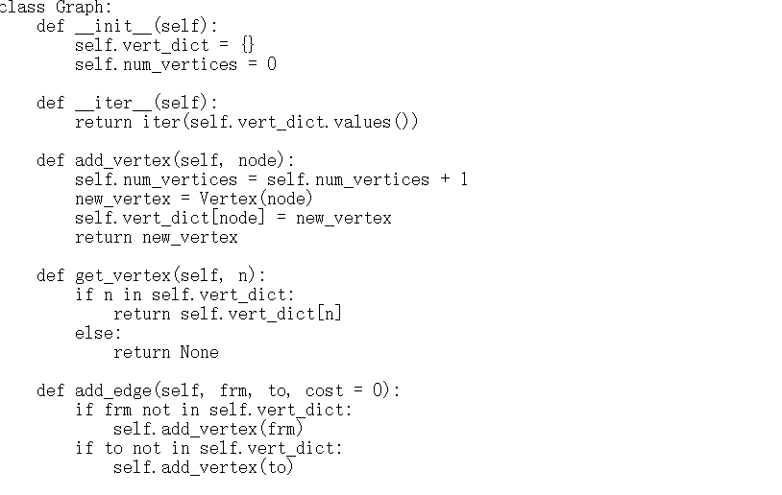
Sample Code （Python2.7）

Slide 21
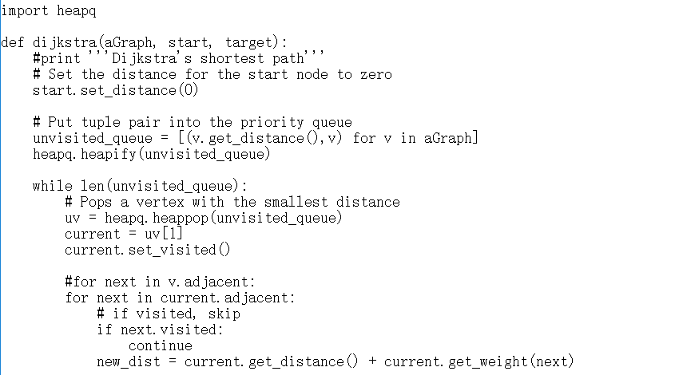
Sample Code （Python2.7）

Slide 22
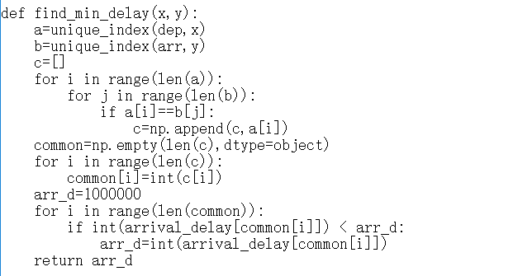
Sample Code （Python2.7）

Slide 23
Test Result
We did a test to find out recommended flights with min delay between JFK to the other 12 airports
oringin_airport | oringin_airport_ID | arrival_airport_ID | arrival_airport | min_delay | reconmmended flights | shortest_path:none for none stop flight
JFK | 12478 | ATL | 10397 | -28 | 43 | 12478','10397'
JFK | 12478 | CLT | 11057 | -31 | 1635 | 12478','11057'
JFK | 12478 | DEN | 11292 | -50 | 2500 | 12478','11292'
JFK | 12478 | DFW | 11298 | -32 | 1223 | 12478','11298'
JFK | 12478 | LAS | 12889 | -51 | 611 | 12478','12889'
JFK | 12478 | LAX | 12892 | -62 | 422 | 12478','12892'
JFK | 12478 | MCO | 13204 | -39 | 2803 | 12478','13204'
JFK | 12478 | MIA | 13303 | -37 | 2190 | 12478','13303'
JFK | 12478 | ORD | 13930 | -42 | 1530 | 12478','13930'
JFK | 12478 | PHX | 14107 | -48 | 1185 | 12478','14107'
JFK | 12478 | SEA | 14747 | -56 | 84 | 12478','14747'
JFK | 12478 | SFO | 14771 | -47 | 478 | 12478','14771'

Slide 24
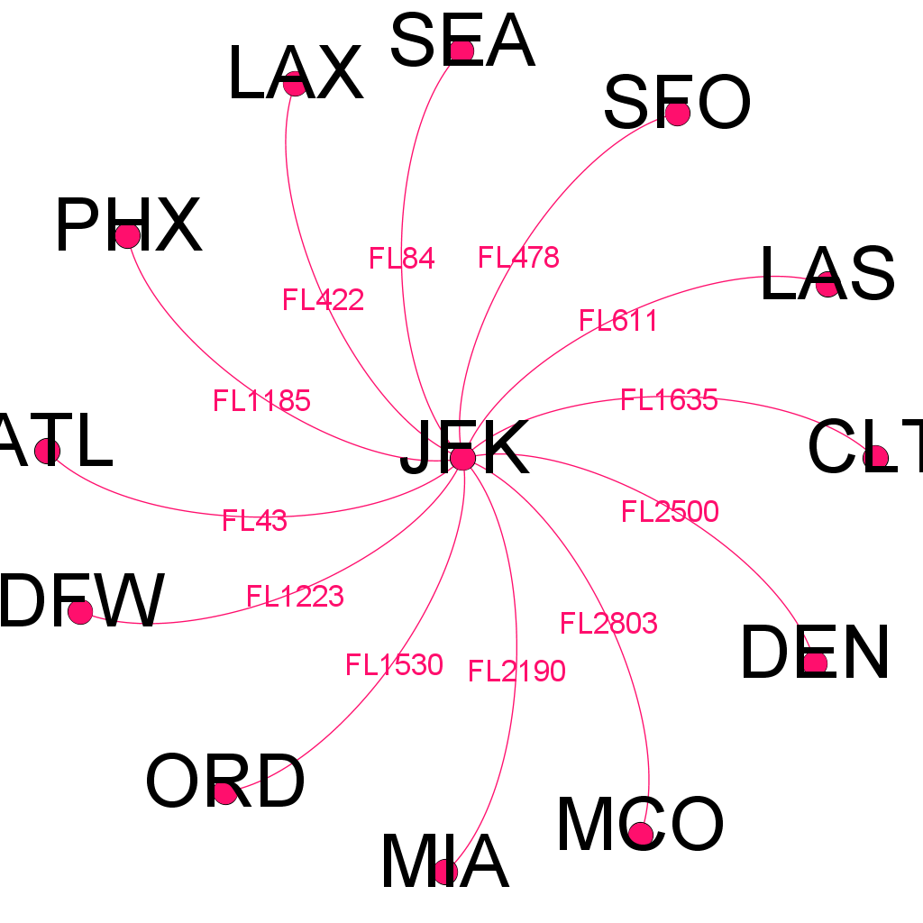
Flight Map

Slide 25
Thanks!
With any problems, send email to:
Shangxing Jiang sjiang25@stevens.edu
Liyan Chen lchen39@stevens.edu
Yanghongbo Lu ylu44@stevens.edu

